Slide 1
CSE 707
Distributed Computing Systems
Course Instructor: Annajiat Alim Rasel
ST: Farah Binta Haque
RA: Sabbir
Name: Ripa Sarkar
ID: 23366009
Team No: 12

Slide 2
Distributed computing in IoT: System-on-a-chip for smart cameras as an example
by Shao-Yi Chien, Wei-Kai Chan, Yu-Hsiang Tseng, Chia-Han Lee, V. Srinivasa Somayazulu, Yen-Kuang Chen

Slide 3
Abstract
Key Components: Sensors, Communications, Computation, and Service in IoT applications.
Challenge: Large-scale data and computation tasks infeasible with centralized cloud solutions.
Solution: Leveraging silicon technology for distributed computing on IoT nodes.

Slide 4
Introduction
IoT in a Nutshell:
Billions of connected smart objects for real-time context sensing and improved services.
Components: Sensors, Communications, Computation, and Service.
Focus on Context Inferring:
Importance of the first three components for local/cloud servers to understand the physical world's conditions.

Slide 5
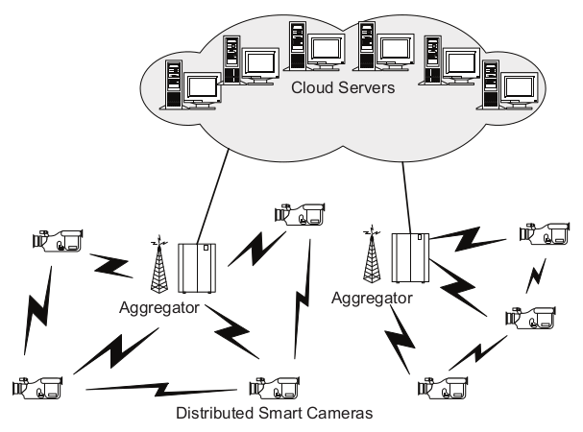
Distributed Computing in Video Sensor Network
Figure 1: Distributed smart camera as a node of an IoT.

Slide 6
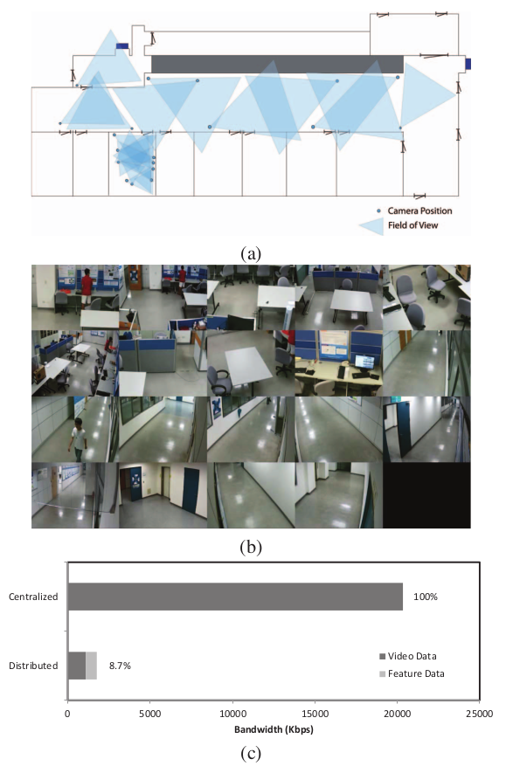
Distributed Computing in Video Sensor Network
A. Video Surveillance Case Study
Scenario: 19 cameras in a BL-7F test bench.
Objective: Store video sequences during critical events.
Approaches: Centralized vs. Distributed.
Results: Distributed approach saves 91.3% of transmission bandwidth, reducing dependency on cloud servers.
Figure 2: (a) The ﬂoor plan and the locations of the surveillance cameras of the BL-7F dataset. (b) The captured videos from these 19 surveillance cameras. (c) The required bandwidth for video transmission with the centralized and distributed approaches.

Slide 7
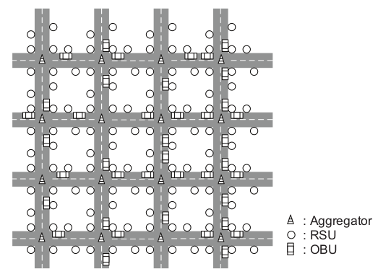
Distributed Computing in Video Sensor Network
B. Vehicle Localization Case Study
System: Neighboring map generation using video cameras in an intelligent transportation system.
Configurations: Three-layer network structure with different sensor and aggregator capabilities.
Results: Bandwidth requirements vary with computing power, demonstrating the impact of distributed computing.
Figure 3: Setting of the simulated vehicle neighboring map generation system with video cameras in an intelligent transportation system.

Slide 8
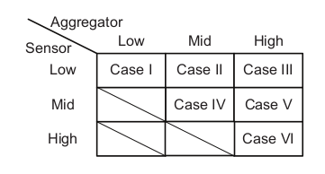
Distributed Computing in Video Sensor Network
Figure 4: Simulation cases.

Slide 9
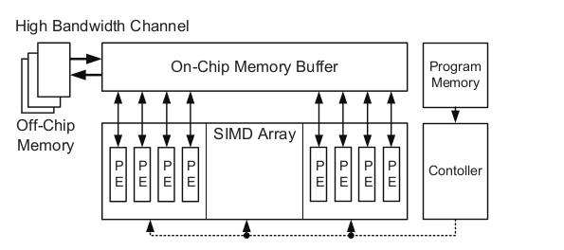
Review of Existing Related Works
Vision Processors: Overview of existing vision processors for video analysis and object recognition.
Focus: High throughput, SIMD architecture, and recent adoption of machine learning engines.
Challenges: Cost, power consumption, and hardware considerations.
Figure 5: Architectural concept of conventional SIMD array.

Slide 10
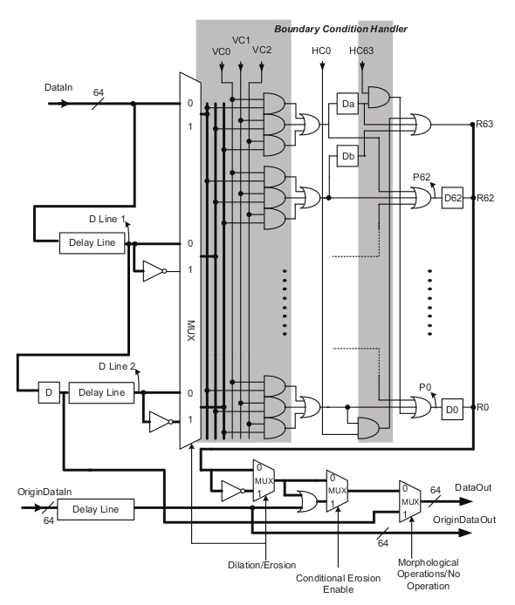
System-on-a-Chip (SoC) for Smart Cameras
A. Reconﬁgurable Smart-camera Stream Processor
Architecture: Coarse-grained reconﬁgurable image stream processor (CRISP) with heterogeneous stream processing (HSP) and subword-level parallelism (SLP).
Components: Reconﬁgurable stage processing element (RSPE), Reconﬁgurable interconnection (RI).
Example: Reconﬁgurable smart-camera stream processor (ReSSP).
Figure 6: Detailed architecture of the Binary Morphology RSPE.

Slide 11
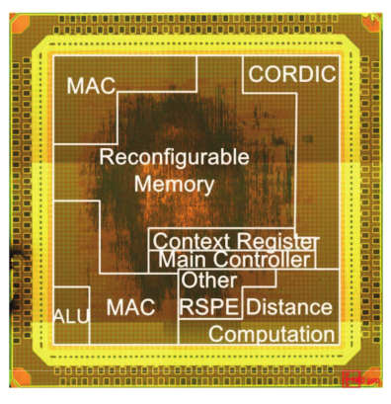
System-on-a-Chip (SoC) for Smart Cameras
B. Implementation Results and Comparisons
Prototype Chip: Fabricated with TSMC 90nm technology.
Advantages: Smaller memory size, higher power efficiency, and area efficiency compared to previous works.
Performance: Real-time execution of video object segmentation, tracking, and SIFT for Full-HD videos.
Figure 7: Die photo.

Slide 12
Conclusion and Future Works
Key Takeaways:
Distributed computing crucial for IoT.
Optimization of computation distribution needed.
Advances in silicon technology enable efficient SoC designs.
Future Work:
Continued SoC design for distributed video sensors.
Consideration of global optimization in the entire network configuration.

Slide 13
References
[1] ITU Internet reports 2005: The Internet of Things. [Online]. Available: http://www.itu.int/internetofthings/
[2] G. Lawton, “Machine-to-machine technology gears up for growth,” IEEE Computer, vol. 37, no. 9, pp. 12–15, Sep. 2004.
[3] Y.-K. Chen, “Challenges and opportunities of internet of things,” in Proc. 17th Asia and South Paciﬁc Design Automation Conference (ASP-DAC), Jan. 2012, pp. 383–388.
[4] B. Rinner and W. Wolf, “An introduction to distributed smart cameras,” Proc. IEEE, vol. 96, no. 10, pp. 1565 – 1575, Oct. 2008.
[5] G. Foresti, C. Micheloni, L. Snidaro, P. Remagnino, and T. Ellis, “Active video-based surveillance systems: the low-level image and video processing techniques needed for implementation,” IEEE Signal Processing Mag., vol. 22, no. 2, pp. 25–37, Mar. 2005.
[6] W.-K. Chan, J.-Y. Chang, T.-W. Chen, Y.-H. Tseng, and S.-Y. Chien, “Efﬁcient content analysis engine for visual surveillance network,” IEEE Trans. Circuits Syst. Video Technol., vol. 19, no. 5, pp. 693–703, May 2009.

Slide 14
THANK YOU

